Slide 1
Internet of Things: Integrating Projects - Drones
John L. Manferdelli
johnmanferdelli@hotmail.com
April 6, 2020, 13:30

Slide 2
Drones, part 1, what are drones, how do they work, how do you spot them
Taxonomy of drones
Anatomy of a drone
Propulsion
Radios
GPS
Cameras
Altimeter
Accelerometer and gyro-compass
Firmware
Control
Detecting and identifying a drone

Slide 3
The Drone (DJI Phantom)
Weight: 3.4 kg.
Control
Maximum pitch: 300 degrees.
Maximum yaw: 150 degrees.
Maximum roll: 35 degrees.
Ascent rate: 5 m/s, descent rate: 4m/s.
Speed (no wind): 10 – 22 m/s.
Battery life (TB47D): 22min (no payload), 20 mins (500g), 13 min (1 kg).
Range: 2km, ceiling: 3000 meters
Picture: Wikipedia

Slide 4
Camera
1” CMOS, Effective Pixels: 20 million
FOV: about 77°
35 mm Format Equivalent: 28 mm
Aperture: f/2.8–f/11
Video: 100-6400
Photo: 100-3200 (auto)
Electronic Shutter: 8–1/8000s
Interval (JPEG: 2/3/5/7/10/15/20/30/60s RAW:5/7/10/15/20/30/60s)

Slide 5
Radios
Controller frequencies:
900MHz
5.8GHz (802.11)
2.4GHZ
Modulation: OFDM (see 802.11 standard)

Slide 6
Sensors
Drone CPU: Myriad 2 VPU (vision processor), quad-core, 4-Plus-1 ARM, low-power NVIDIA Kepler-based processor, 16 GB eMMC 4.51 storage.
IMU (gyroscope and accelerometer): similar to MPU-6050 (I2C and SPI)
MEMS 3-axis gyroscope (Coriolis effect) – drift of up to .5 degrees/sec
3-axis accelerometer - errors around 1%
Compass
3-Axis Digital Compass IC HMC5883L
1° to 2° compass heading accuracy
Barometric altimeter
MS5803-14BA
20 mbar accuracy
GPS (including oscillating denial and deception)
LS20033-2R/MediaTek MT3337
Serial protocol

Slide 7
Gyroscope Stability
Grade | Stability (deg/hr)
Commercial | >30
Industrial | 1-30
Tactical | .1-30
Navigational | .1-1
Strategic | .01

Slide 8
Detection
Best early detection
2 km (X-band radar, optical, acoustic)
Can be reduced by shielding, anti-stealth, quieting
Need to act quickly
10-20 m/s flight speed, 100 second response window

Slide 9
Drones, part 2, how to drive unmanned aircraft
Navigation
Trajectories around earth
Spherical geometry: distance, bearing
Control
Thrust and lift: parameters of “heavier than air” vehicles
Attitude: roll, pitch and yaw
Mission planning
Waypoints
Endurance
Stealth

Slide 10
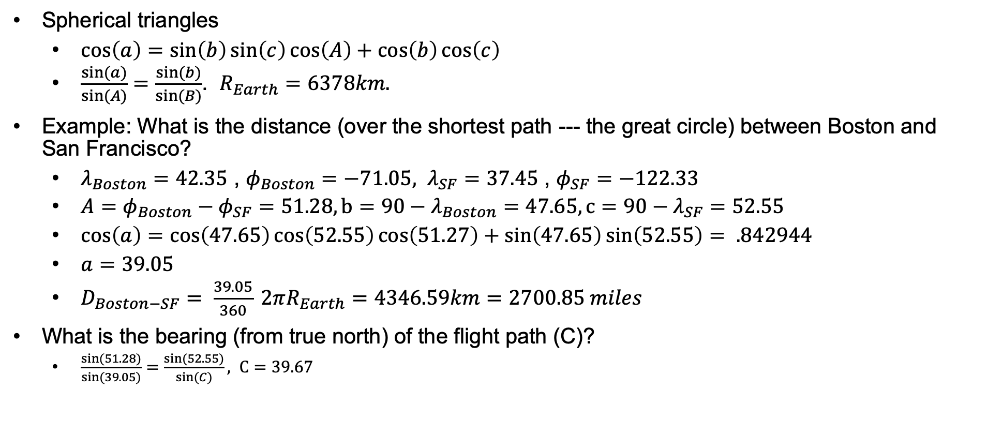
Navigation
Diagram: Wikipedia
Spherical triangles
$\cos\left(a\right)=\sin\left(b\right)\sin\left(c\right)\cos\left(A\right)+\cos\left(b\right)\cos\left(c\right)$
$\frac{sin⁡(a)}{sin⁡(A)}=\frac{sin⁡(b)}{sin⁡(B)}$. $R_{Earth}=6378km.$
Example: What is the distance (over the shortest path --- the great circle) between Boston and San Francisco?
$λ_{Boston}=42.35$ , $φ_{Boston}=−71.05, λ_{SF}=37.45$ , $φ_{SF}=−122.33$
$A=φ_{Boston}−φ_{SF}=51.28, b=90−λ_{Boston}=47.65, c=90−λ_{SF}=52.55$
$\cos\left(a\right)=\cos\left(47.65\right)\cos\left(52.55\right)\cos\left(51.27\right)+\sin\left(47.65\right)\sin\left(52.55\right)= .842944$
$a=39.05$
$D_{Boston−SF}= \frac{39.05}{360} 2πR_{Earth}=4346.59km=2700.85 miles$
What is the bearing (from true north) of the flight path (C)?
$\frac{sin⁡(51.28)}{sin⁡(39.05)}=\frac{sin⁡(52.55)}{sin⁡(C)}, C=39.67$

Slide 11
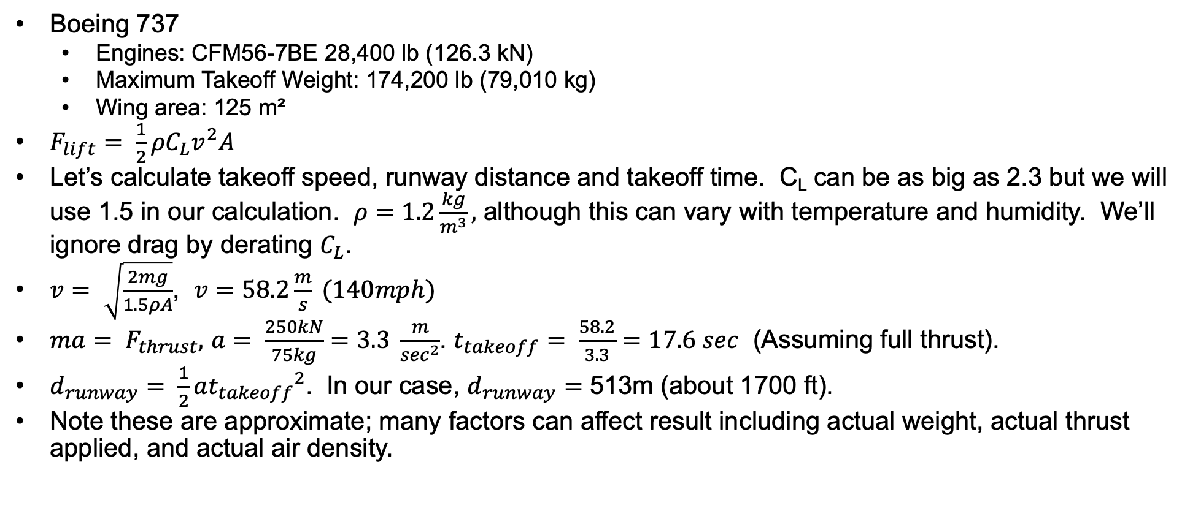
Introduction to aeronautics
Diagram: Wikipedia
Boeing 737
Engines: CFM56-7BE 28,400 lb (126.3 kN)
Maximum Takeoff Weight: 174,200 lb (79,010 kg)
Wing area: 125 m²
$F_{lift}= \frac{1}{2}ρC_{L}v^{2}A$
Let’s calculate takeoff speed, runway distance and takeoff time. C_{L} can be as big as 2.3 but we will use 1.5 in our calculation. $ρ=1.2\frac{kg}{m^{3}},$ although this can vary with temperature and humidity. We’ll ignore drag by derating $C_{L}$.
$v= \sqrt{\frac{2mg}{1.5ρA}}$, $v=58.2\frac{m}{s} (140mph)$
$ma= F_{thrust},$ $a= \frac{250kN}{75kg}=3.3 \frac{m}{\sec^{2}}$. $t_{takeoff}= \frac{58.2}{3.3}=17.6 sec$ (Assuming full thrust).
$d_{runway}= \frac{1}{2}a{t_{takeoff}}^{2}$. In our case, $d_{runway}=$ 513m (about 1700 ft).
Note these are approximate; many factors can affect result including actual weight, actual thrust applied, and actual air density.

Slide 12
Waypoints and drone navigation
Same roll, pitch and yaw angles used to describe flight.
Drone accelerated by tipping rotors down a little.
Usually, we navigate to intermediate “waypoint.”
Total journey consists of sequence of waypoints (like 737, listen to air traffic control).
Given current location (say latitude and longitude) and next waypoint (latitude and longitude), we calculate bearing and use the compass. Head that way.
We could also use the camera for navigation if the terrain is familiar.

Slide 13
Drones, part 3, critical RF dependencies
GPS fundamentals
RF effects
Jamming drone control and data channels

Slide 14
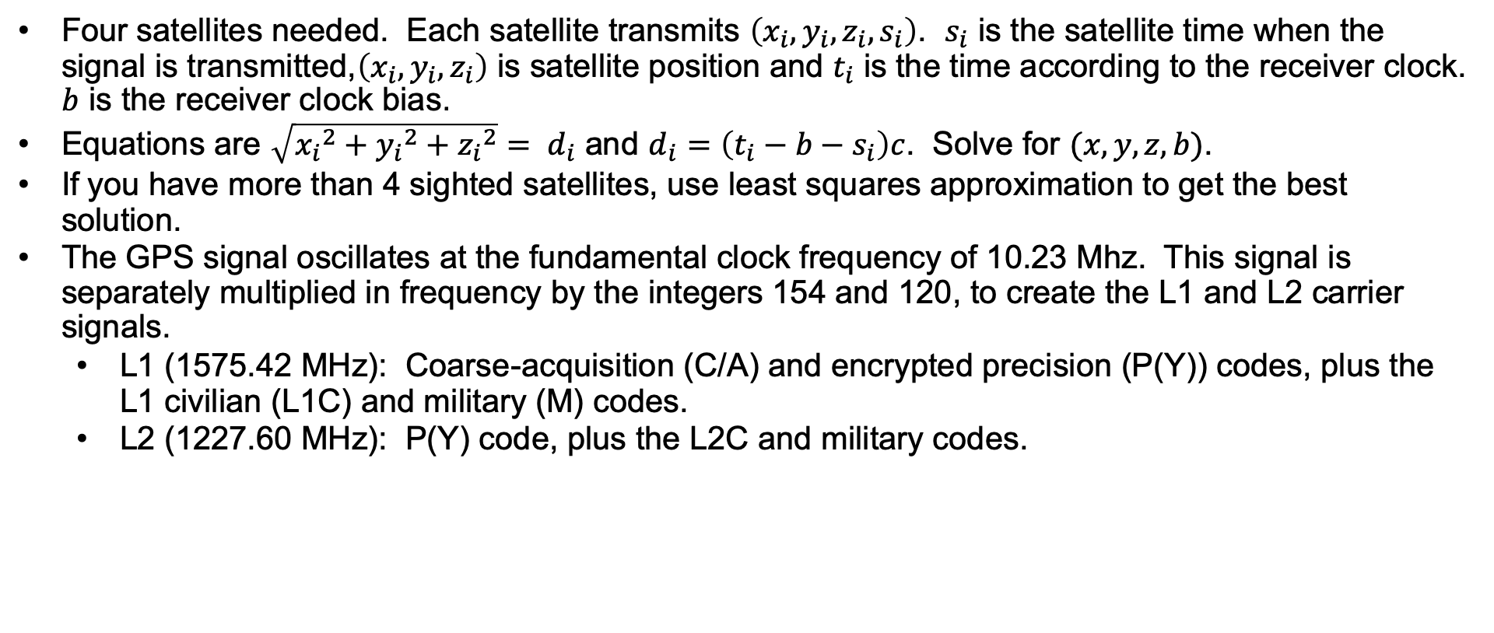
GPS
Four satellites needed. Each satellite transmits $\left(x_{i},y_{i},z_{i},s_{i}\right)$. $s_{i}$ is the satellite time when the signal is transmitted,$\left(x_{i},y_{i},z_{i}\right)$ is satellite position and $t_{i}$ is the time according to the receiver clock. $b$ is the receiver clock bias.
Equations are $\sqrt{{x_{i}}^{2}+{y_{i}}^{2}+{z_{i}}^{2}}= d_{i}$ and $d_{i}=\left(t_{i}−b−s_{i}\right)c$. Solve for $(x,y,z,b)$.
If you have more than 4 sighted satellites, use least squares approximation to get the best solution.
The GPS signal oscillates at the fundamental clock frequency of 10.23 Mhz. This signal is separately multiplied in frequency by the integers 154 and 120, to create the L1 and L2 carrier signals.
L1 (1575.42 MHz): Coarse-acquisition (C/A) and encrypted precision (P(Y)) codes, plus the L1 civilian (L1C) and military (M) codes.
L2 (1227.60 MHz): P(Y) code, plus the L2C and military codes.

Slide 15
GPS
The satellite constellation is designed to have at least 4 satellites in view anytime for any location. Information is encoded using phase modulation. The binary digits 0 and 1 are represented by multiplying the electrical signals by either +1 or −1, which is equivalent to leaving the signal unchanged, or flipping the phase of the signal by 180.
There are three types of code on the carrier signals: the C/A code, the P code, and the navigation code.
The C/A (“coarse acquisition”) code is on L1 channel and repeats every 1 ms at a rate of 1.023 Mbps. The C/A code contains is the time according to the satellite clock. Each satellite has a different C/A code, so that they can be uniquely identified.
The P (“precise”) code is identical on the L1 and L2 channel. The P code repeats every 267 days, the code is divided into 7 day segments; each with a “PRN” number. The basic information is the satellite clock time with ten times the resolution as the C/A code. Unlike the C/A code, the P code can be encrypted by a process known as “anti-spoofing”, or “A/S”.
The navigation message is on the L1 channel, transmitted at 50 bps. It is a 1500 bit sequence, and takes 30 seconds to transmit. The navigation message includes the broadcast ephemeris (satellite orbital parameters), satellite clock corrections, almanac data, ionosphere information, and satellite health status.
Thanks, DARPA.

Slide 16
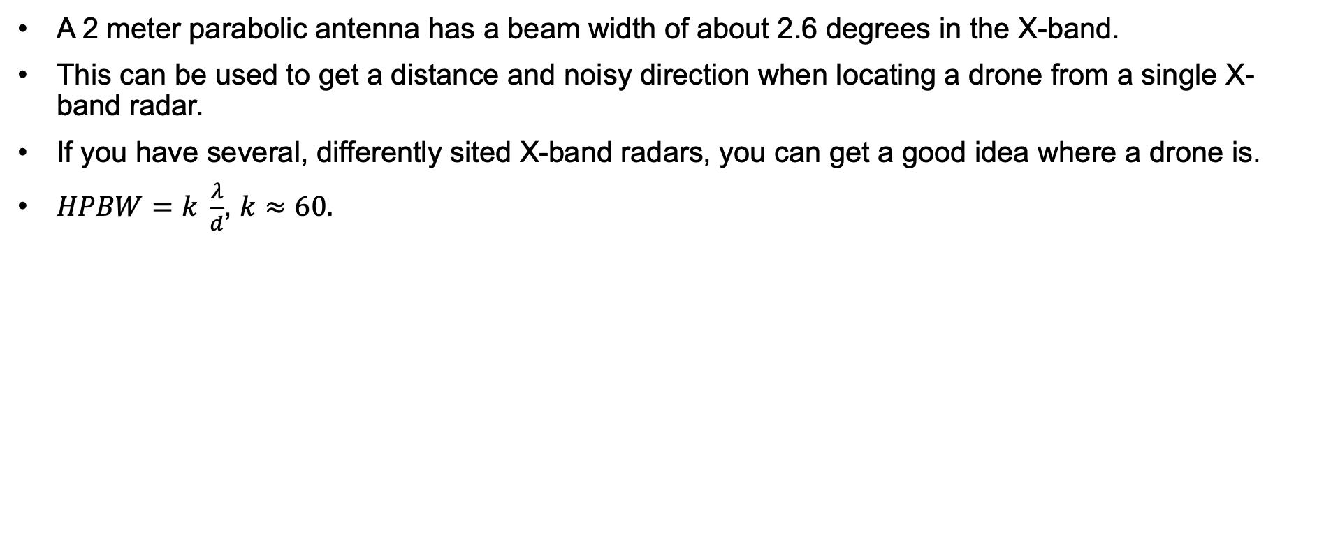
Directional antennas
A 2 meter parabolic antenna has a beam width of about 2.6 degrees in the X-band.
This can be used to get a distance and noisy direction when locating a drone from a single X-band radar.
If you have several, differently sited X-band radars, you can get a good idea where a drone is.
$HPBW=k \frac{λ}{d}$, $k≈60.$

Slide 17
Drones, part 4 : real life drones
x

Slide 18
DJI P3P
Motor
LEDs
Gimbal
Motor
DM365 (ARM)
Ambarella A9
STM32
Camera
Motor
DSP
NAND
Motor
USB
USB
UART
ANT
BAT
ESC-Board
UART
OFDM Board
Motor Preamp
MOSFETs
TMSS320F
STM32
Cyclone V FPGA
MAX3051 (CAN)
SPI
EEPROM (Bitstream)
Transceiver
VPS (Virtual Positioning)
UART
Flight Controller
Camera
Sonar
IMU
Baro
HSM
STM32
STM32
GPS
UART
USB
U-Blox
I2C
Compass

Slide 19
Drone software
Software supporting drones includes:
Device firmware
Navigation and flight control
Image processing
Sensor processing
Operating system
Applications
There is proprietary software like DJI.
There is open source software like PX4.

Slide 20
References
Sandia, UAS Detection, Classification, and Neutralization: Market Survey 2015.
Dept 13, Anatomy of DJI’s Drone Identification Implementation.
DJI Drone manual.
Boeing 737 aircraft manual.
Karl Koscher, Securing Embedded Systems: Analyses of Modern Automotive Systems and Enabling Near-Real Time Dynamic Analysis. Thesis, UW.

Slide 21
Exercises
Find measurable quantities (rise/fall times, ...) to fingerprint and subsequently identify a drone.
Identify a drone using protocol parameters.
What is the GPS signal strength you’d expect?
If you had to rely on commercial grade (MEMS) gyroscope alone, using dead reckoning, how far off would you be in an hour?
What about a navigation grade gyroscope?
What is the height error when your barometer is off by 20 mbar? (1 bar is standard atmospheric pressure at sea level)

Slide 22
License
This material is licensed under Apache License, Version 2.0, January 2004.
Use, duplication or distribution of this material is subject to this license and any such use, duplication or distribution constitutes consent to license terms.
You can find the full text of the license at: http://www.apache.org/licenses/.

